Slide 2
Expense reporting backlog
Improve architecture, maintainability, and quality
Adopt a services architecture
Improve accessibility, scalability, and operations
Move to the cloud
Update the user experience
Build a more modern-looking user experience
Expand device support
Companion apps for Windows Store and Windows Phone

Slide 3
Agenda
Modernize your platform
.NET & WPF improvements since 4.0
Modernize your tools
Visual Studio 2013
Modernize your user experience
Touch, toast, 3rd party controls

Slide 4
Modernize Your Tools

Slide 5
.NET & WPF improvements since 4.0
Since .NET 4.0
async/await & PLINQ
Portable Class Libraries
Zip compression
Web Bootstrapper replaces Client Profile Installer for online scenarios
SQL connection resiliency
Since WPF 4.0
Collections support modification from non-UI threads
Improved support for Weak References to events
Async data validation
Binding to static properties
Ribbon control

Slide 6
Visual Studio 2013 XAML improvements
IntelliSense for data binding and resources
Go to definition (F12) for resources and types
Commenting markup supports nesting of comments
Renaming a start tag also renames matching end tag
Support for adding XAML code snippets
All these improvements now also available for WPF, Silverlight and Windows Phone
Notes:
IntelliSense for data binding shows you the possible completions for the DataContext when available.
IntelliSense for resources shows you all the resources that are applicable in a given scope and that match the property type you are trying to assign the resource to.
Go to definition (F12) for resources to quickly jump to the document that contains the resource no matter where it defined in your project.
Go to definition (F12) for types, properties and bindings to quickly navigate to the declaration of the type, property or binding in your Model/ViewModel.
Commenting markup supports nesting of comments within the selected range in the text editor.
Renaming a start tag also renames the matching end tag.
Support for adding XAML code snippets.

Slide 7
Demo
Visual Studio 2013
Name

Slide 8
Modernize Your
User Experience

Slide 9
Touch
Windows 8 is the best Windows operating system for touch input
Windows Store & Windows Phone apps are optimized for touch input and provide the best touch experience
Desktop Applications such as WPF can be enhanced for better touch support through custom code or 3rd party controls

Slide 10

Windows 8 toast notifications
Pop-up notifications in the upper right corner of the screen
A user can select the toast (touch or click) to launch the associated action
Toast notifications can be sent by Windows Store and Windows Desktop applications

Slide 11
DevExpress WPF Controls
Optimized for desktops, ready for mobile
Built so you can deliver elegant line-of-business applications that emulate the touch-first Windows 8 UX and maintain backward compatibility with previous versions of the Windows operating system.
https://www.devexpress.com/products/net/controls/wpf/
http://www.devexpress.com/touch

Slide 12
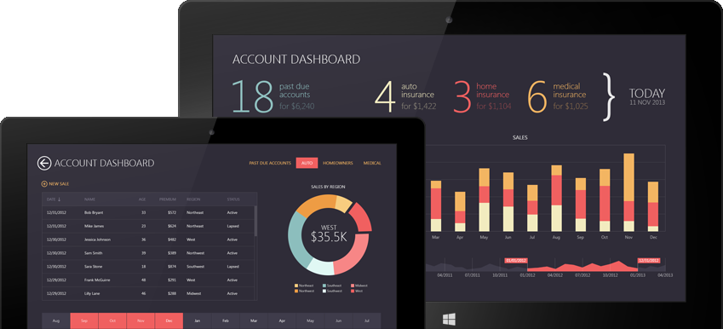
DevExpress WPF Controls
Touch-Enabled Controls Used in this App
Data Grid
Charts
Range Control

Slide 13
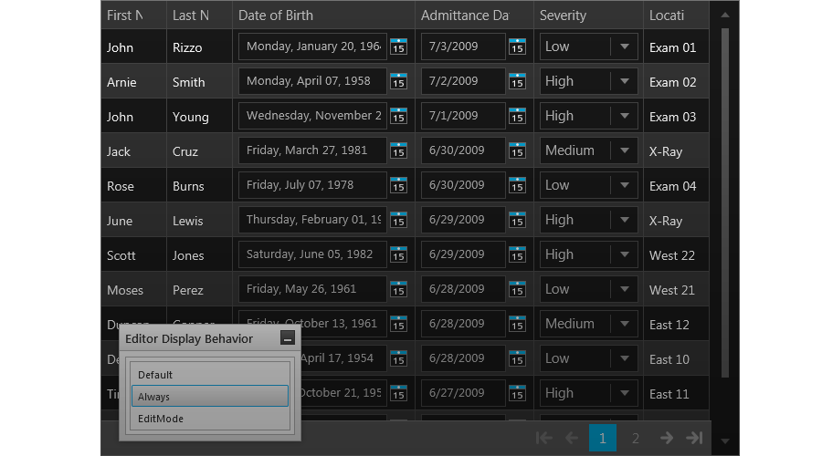
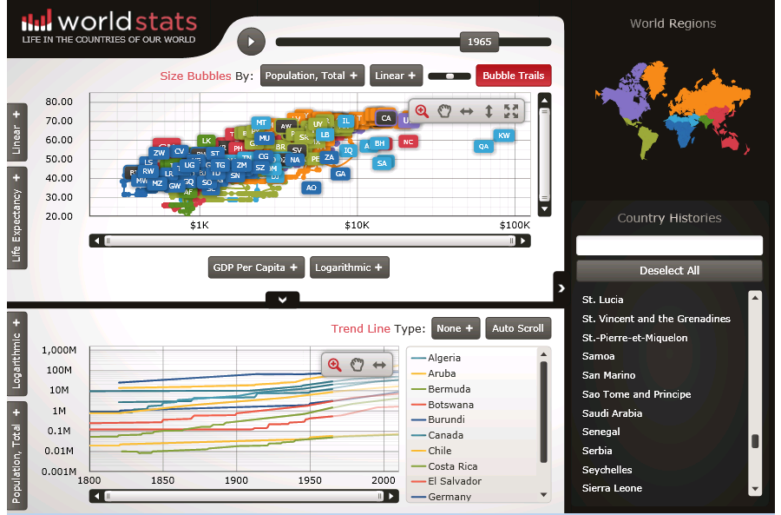
Infragistics Ultimate
Fastest Data Grid
Stunning Charts
http://www.infragistics.com/products/wpf/
Notes:
Speed and Scalability
When it comes to your Windows applications, performance matters. If you have massive amounts of data that requires lightning-fast processing, only the industry’s top-performing controls will do. No other Data Grid on the market can even compare to the power and performance level you get with the Infragistics WPF Data Grid.
Over 50 Different Charts, Each One Faster than the Next
Render millions of data points within milliseconds with the world's fastest WPF Data Chart. Animate data over time using the innovative Motion Framework and glean further intelligence from gauges and bullet charts. Plot and interact with geospatial data using rich new features typically reserved for dedicated geospatial developers, thanks to a partnership with the premier supplier of Geographic Information System software.

Slide 14
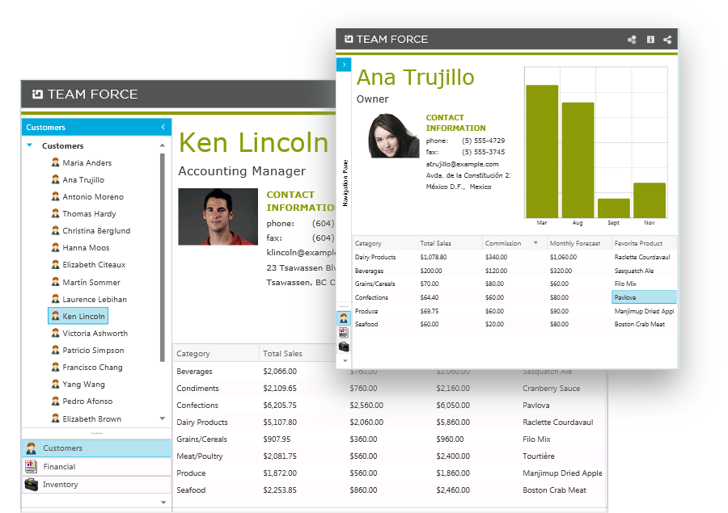
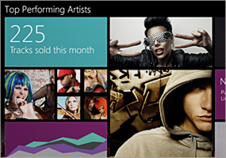
Infragistics Ultimate
Build Office Inspired Apps
Get Your 30 Day Free Trial of WPF Controls as Part of Infragistics Ultimate.
Notes:
The Experiences Your Customers Already Know
One of the best ways to reduce training time is to create applications that look like the apps your customers already know. With Infragistics, building your next application based on Microsoft Outlook or Microsoft Word is easy.

Slide 15
ComponentOne Studio for WPF
Touch-enabled WPF controls with modern themes
Inertial Scrolling for DataGrids/ListBoxes
Pinch Scaling for Maps/Viewers
Five Modern Themes for all controls, even standard ones
http://www.componentone.com/SuperProducts/StudioWPF/

Slide 16
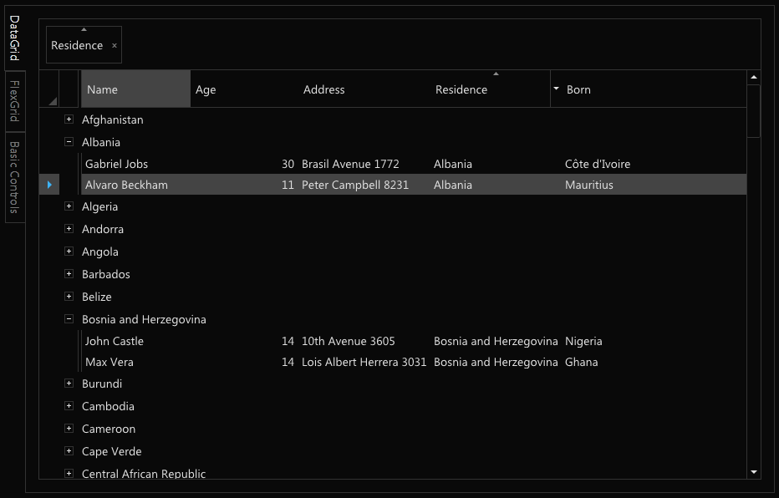
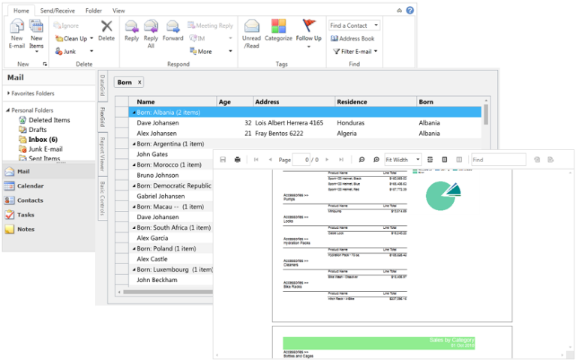
ComponentOne Studio for WPF
Five Modern Themes
Cosmopolitan
Cosmopolitan Dark
Office 2013 White
Office 2013 Light Gray
Office 2013 Dark Gray

Slide 17
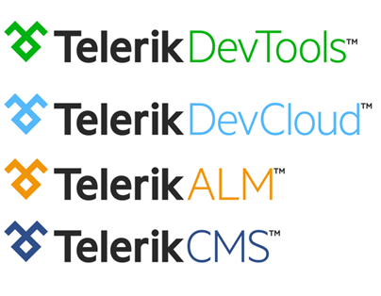
The Telerik Portfolio
Made for developers. Strong enough for the enterprise.
Build
Connect
Test
Deliver
Plan
http://www.telerik.com/products/wpf/overview.aspx

Slide 18
Demo
Third party controls
Name

Slide 19
Summary
Modernize your platform
.NET & WPF improvements since 4.0
Modernize your tools
Visual Studio 2013
Modernize your user experience
Touch, toast, 3rd party controls

Slide 20
Resources
XAML Editor Improvements in Visual Studio 2013
http://blogs.msdn.com/b/visualstudio/archive/2013/08/09/xaml-editor-improvements-in-visual-studio-2013.aspx
Modernizing WPF Line-of-Business Applications
http://channel9.msdn.com/Events/TechEd/NorthAmerica/2013/DEV-B3258
DevExpress Controls for XAML Developers
http://channel9.msdn.com/Shows/Visual-Studio-Toolbox/DevExpress-Controls-for-XAML-Developers

Slide 21
Resources
Infragistics Controls for XAML Developers
http://channel9.msdn.com/Shows/Visual-Studio-Toolbox/Infragistics-Controls-for-XAML-Developers
Telerik Controls for XAML Developers
http://channel9.msdn.com/Shows/Visual-Studio-Toolbox/Telerik-Controls-for-XAML-Developers
ComponentOne Controls for XAML Developers
http://channel9.msdn.com/Shows/Visual-Studio-Toolbox/ComponentOne-Controls-for-XAML-Developers

Slide 23

© 2013 Microsoft Corporation. All rights reserved. Microsoft, Windows, and other product names are or may be registered trademarks and/or trademarks in the U.S. and/or other countries.
The information herein is for informational purposes only and represents the current view of Microsoft Corporation as of the date of this presentation. Because Microsoft must respond to changing market conditions, it should not be interpreted to be a commitment on the part of Microsoft, and Microsoft cannot guarantee the accuracy of any information provided after the date of this presentation.
MICROSOFT MAKES NO WARRANTIES, EXPRESS, IMPLIED OR STATUTORY, AS TO THE INFORMATION IN THIS PRESENTATION.

